Slide 1
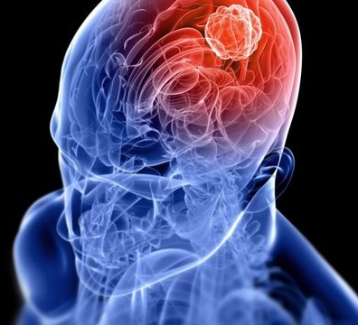
Brain Tumor detection using machine learning:
By Neeraj Parihar,
Pankaj giri goswami

Slide 2
Contents
Introduction
Significance of Brain Tumor Detection
Challenges in Brain Tumor Detection
Deep Learning for Brain Tumor Detection
Popular Deep Learning Architectures for Brain Tumor Detection
Data Preparation and Augmentation
Model Training and Evaluation
Applications of deep Learning in Brain Tumor Detection
Future Directions
Conclusions

Slide 3
Introduction
Brain tumors are among the leading causes of cancer-related deaths worldwide, posing a significant challenge to the medical field.
Early detection of brain tumors is crucial for improving patient outcomes and survival rates.
Deep learning has emerged as a powerful tool for medical image analysis, offering promising results in brain tumor detection
Notes:
Consider talking about:
Convolutional
Pooling
Fully connected
Receptive field
Weights

Slide 4
Significance of Brain Tumor Detection
Accurate brain tumor detection provides crucial information for:
Timely diagnosis and intervention
Treatment planning, including surgery, radiation therapy, and chemotherapy
Monitoring tumor progression and treatment response
Notes:
Consider talking about:
Receptive fields in the visual cortex
Neocognitron, origin of the CNN architecture
Time delay neural networks
Image recognition with CNNs trained by gradient descent
Shift-invariant neural network
Neural abstraction pyramid
GPU implementations
Intel Xeon Phi implementations

Slide 5
Challenges in Brain Tumor Detection
Medical imaging modalities, such as MRI and CT scans, can be complex and difficult to interpret due to:
Subtle tumor characteristics
Variations in image quality
Presence of artifacts and noise
Manual detection by radiologists is time-consuming and subjective, leading to inconsistencies.

Slide 6
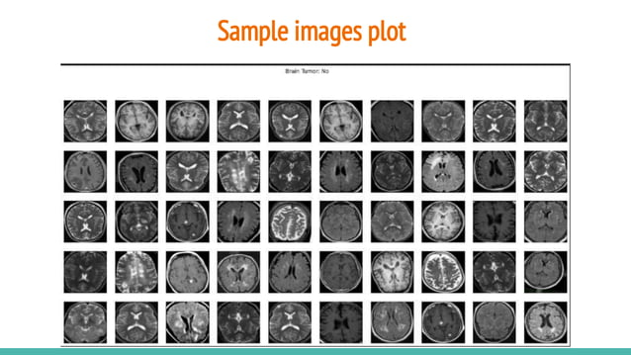

Slide 7
Deep Learning for Brain Tumor Detection
Deep learning, a subset of machine learning, has revolutionized image analysis tasks.
Convolutional neural networks (CNNs) are particularly well-suited for medical image analysis due to their ability to extract high-level features from images.
Deep learning models can be trained on large datasets of labeled medical images to learn the patterns and characteristics of brain tumors.t
Notes:
Consider talking about:
Convolutional layer
Pooling layer
ReLU layer
Fully connected layer
Loss layer

Slide 8
Deep Learning Libraries for Brain Tumor Detection
TensorFlow: An open-source software library for numerical computation using data flow graphs. It is used for machine learning and deep learning activities.
OpenCV: An open-source library for computer vision. It can be used for tasks such as image processing, video analysis, and real-time object detection.
NumPy: A fundamental library for scientific computing with Python. It provides a comprehensive array of high-level mathematical functions, linear algebra operations, routines for generating random numbers, and tools for integrating C and Fortran code.
scikit-learn: A machine learning library for Python. It provides a wide range of tools for supervised and unsupervised learning, including classification, regression, clustering, and dimensionality reduction.
Keras: A high-level neural networks API for Python. It provides a user-friendly interface for building and training neural networks with a focus on simplifying the deep learning process.
Notes:
Consider talking about:
Number of filters
Filter shape
Max pooling shape

Slide 9
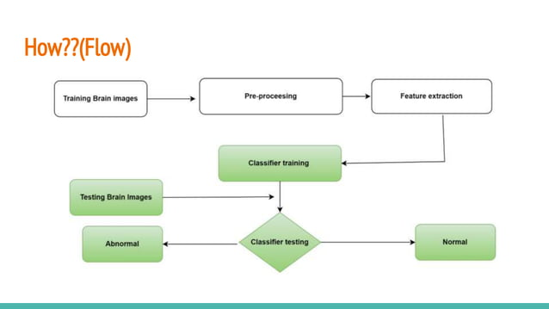

Slide 10
Data Preparation and Augmentation
Data preparation is a crucial step in deep learning for brain tumor detection.
Preprocessing techniques include image normalization, skull stripping, and bias field correction.
Data augmentation involves artificially increasing the size of the training dataset by applying transformations to existing images, such as flipping, rotating, and resizing.
Notes:
Consider talking about:
Empirical
Explicit

Slide 11
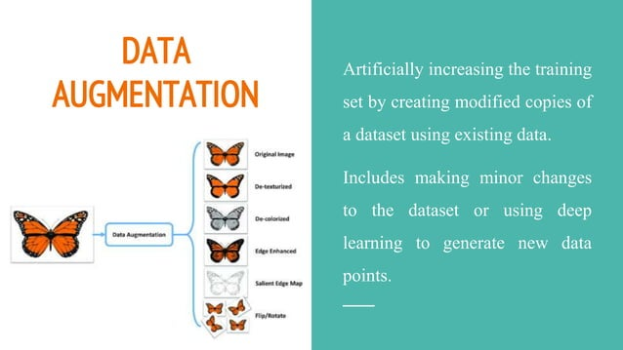

Slide 12
Model Training and Evaluation
Model training involves optimizing the model parameters to minimize the classification error on a training dataset.
Evaluation metrics, such as accuracy, precision, recall, and F1-score, are used to assess the performance of the trained model on a validation dataset.
Hyperparameter tuning involves adjusting model parameters to achieve optimal performance.

Slide 13
Applications of deep Learning in Brain Tumor Detection
Deep learning-based detection methods are being used in clinical practice to assist radiologists in tumor detection.
Computer-aided detection (CAD) systems can improve the sensitivity and specificity of tumor detection, leading to earlier diagnoses.
Deep learning models can also be used to analyze large datasets of patient scans to identify patterns and correlations that may lead to new insights into brain tumor biology and early detection biomarkers.
Notes:
Consider talking about:
Image recognition
Video analysis
Natural language processing
Drug discovery
Health risk assessment and biomarkers of aging discovery
Checkers game
Go
Time series forecasting

Slide 14
Future directions
Development of more robust and generalizable deep learning models for brain tumor detection, including multi-modal detection approaches.
Integration of deep learning with other clinical data, such as patient demographics and medical history, for improved risk assessment and personalized treatment planning.
Exploration of explainable AI techniques to understand the decision-making process of deep learning models and enhance their clinical trust and acceptance.

Slide 15
conclusion
Deep learning has revolutionized brain tumor detection, offering promising results in terms of accuracy, efficiency, and automation.
Continued research and development in deep learning will further enhance the capabilities of these methods and lead to earlier diagnoses, improved patient outcomes, and personalized treatment strategies.

